Slide 1
VHC
Sprint Demo : 2023 - 03 - 27

Slide 2




Table of Contents
1- SPRINT GOAL
2- STATUS
3- DEMO
4- FEEDBACK

Slide 3
FAQ: - When do we select new goals? In the review - When do we create new user stories in the planning - When do we create new tasks? In the backlog meeting

Slide 4
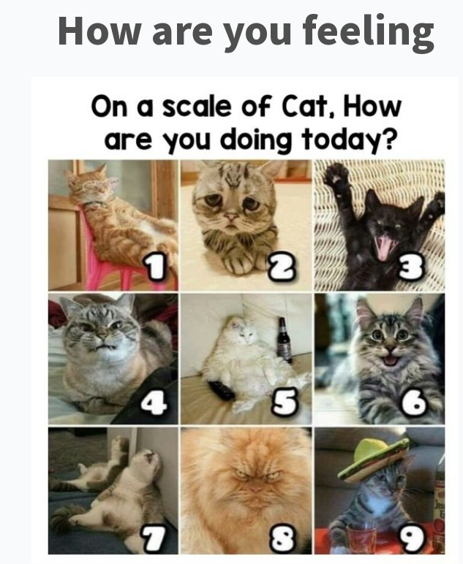

Slide 5
What were the goals this sprint

Slide 6




Een Gestructueerde file, een ongestructueerde file, - NoSQL – SQL - 1 Scraped
DataSet – Universiteit lobbyig: Dataset Gent
DATA: 3 verschillende (echte) soort data waar je de Code op maakt Waar je de JSON File uit genereert. Liefst via API.
Programeren: met de 3 data iputs automatische in de Graph word gezet.
Partnerships: Eerste Versie van de website, die verteld en een interface, plan board, word adventure en naar de tools.
Data Scraper Bouwen: die de files in de database zet.
Gitbook koppelen
Goed beschrijven waar komt het vandaan, waarom is het relevant, wat is de kwaliteit, wat zijn de kenmerken.

Slide 7
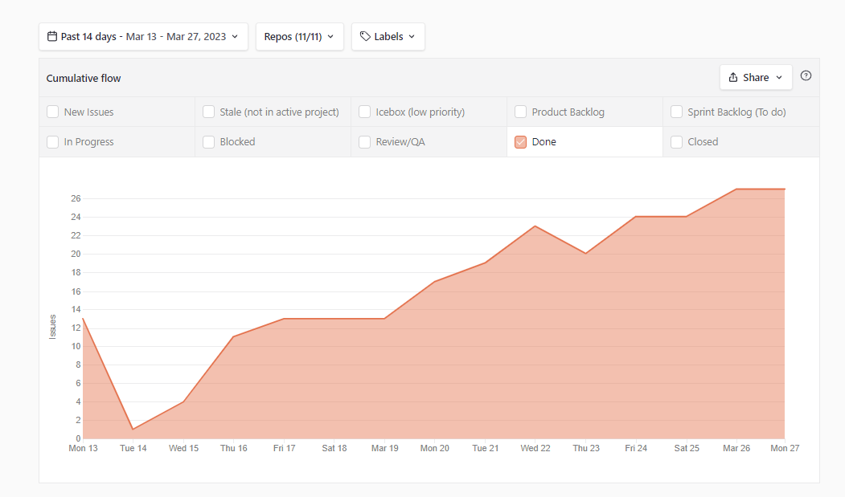
Cumulative Flow Diagram

Slide 8



🏗️DEV
🎨DESIGN
🏉ADMIN/SCRUM
🤝BD
TASK
Direct value
Enablers
🏗️Taiga Board Now Operational: Scrum Framework working: And publicly available
🏗️ Selecting D3.JS virtual tools
🏗️ Developer environment done
🏗️ First app build “version”
🏗️Website Version One Build
🏗️Documentation Templates Done
🏗️ Organisation of Tasks – increases accountability + Reduces chances of Restart
✔️saves $$/month
🏗️Staging demo prepared
✔️stakeholders see app working
🏗️Development environment done ✔️Speeds up future work
✔️Can do things normal evironments cannot
✔️Preparation for future members
🎨 Created Scripts to Automatically install nessesairy Software
✔️Will help us onboard faster
🎨 Clockify helps us track time spend vs ✔️Keep Track of Effort Done
🎨 Docker – App – Portainer for Language and models
🎨 Visual workplace – Fun For Collab

Slide 9

Demo

Slide 10
🎨DESIGN
🎨Demo design includes code preview for devs

Slide 11
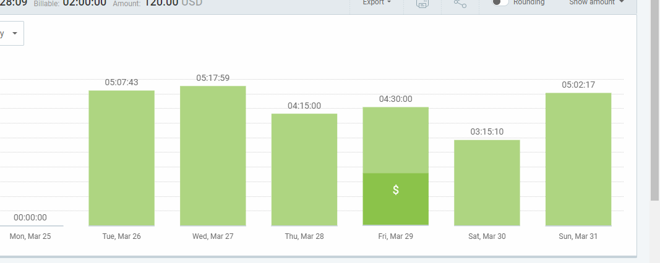
🎨ORGANISATION & Planning

Slide 12
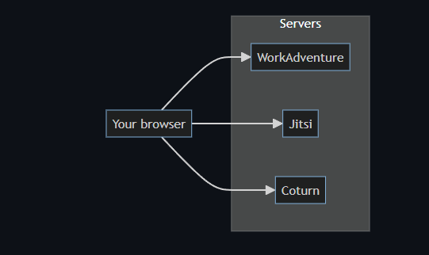
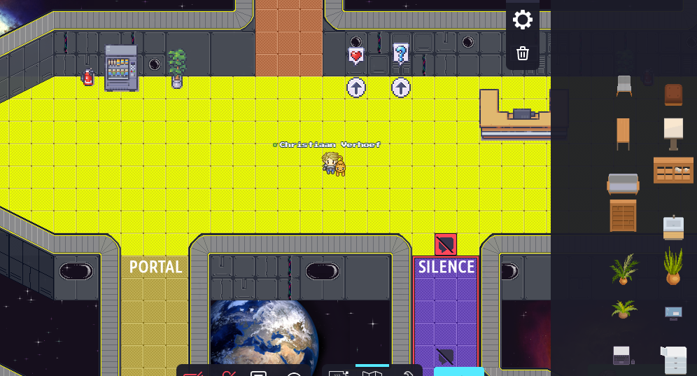
🎨 Social Media & outreach
WORK ADVENTURE!!!!

Slide 13
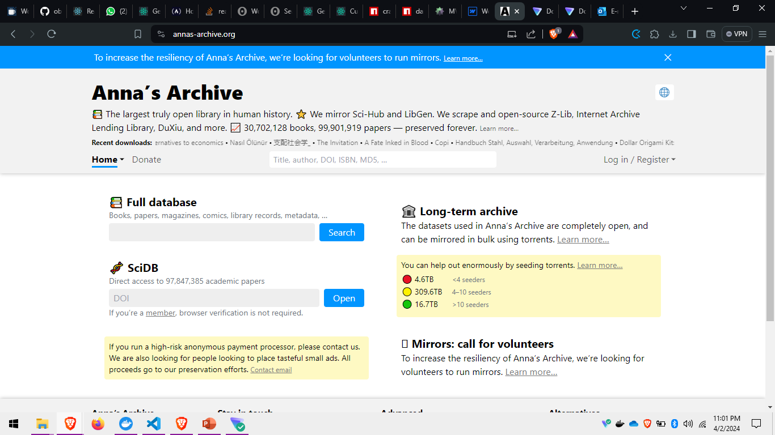
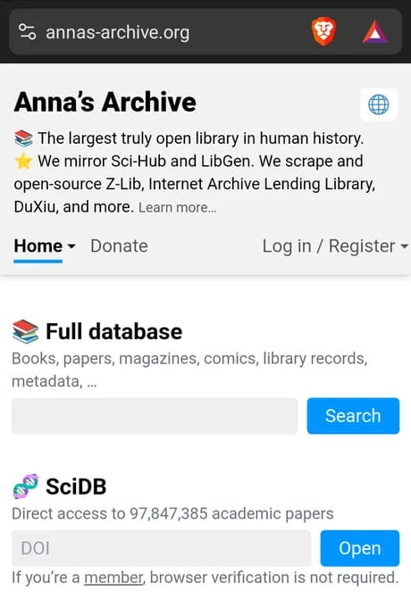
🎨DATA

Slide 14
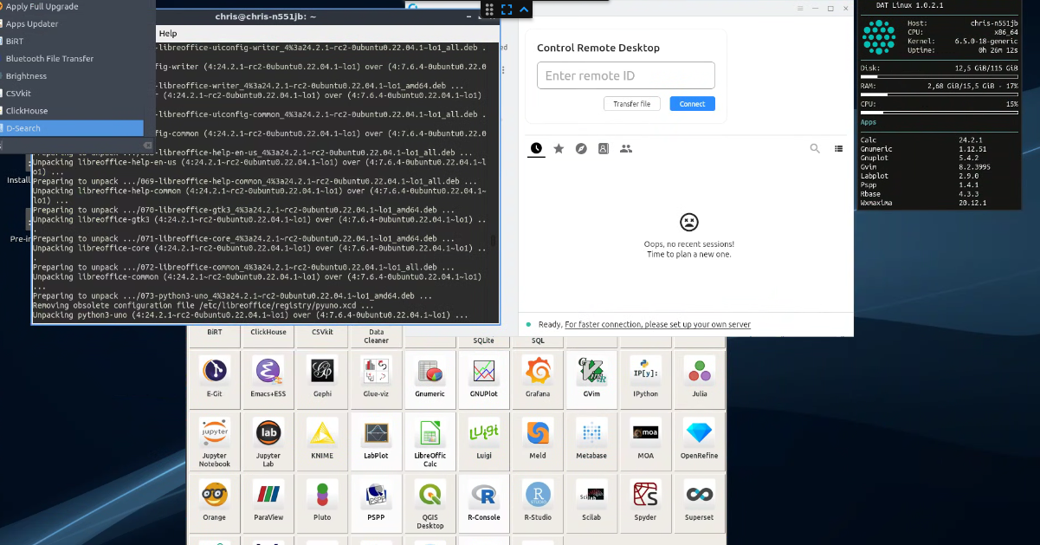
Automation + Setup

Slide 15
🎨Knowledge

Slide 16
🏗️DEV
🏗️User is initialized from storage on app start and invalid users logged out
If the user logs into another device the user should be logged out of their current device;
🏗️PIN challenge screen UI
🏗️Change PIN and Biometrics choice screen UI
The Tonomy ID app now has change PIN and biometric and PIN challenge screens visually implemented (but no logic)
🏗️Back button logic on home screen
If the user presses the OS back button on the home screen, they should exit the app.

Slide 17
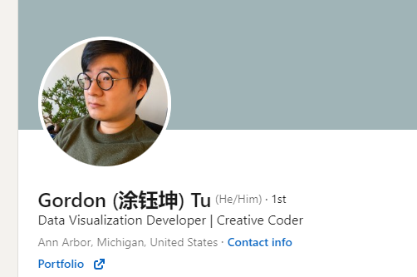
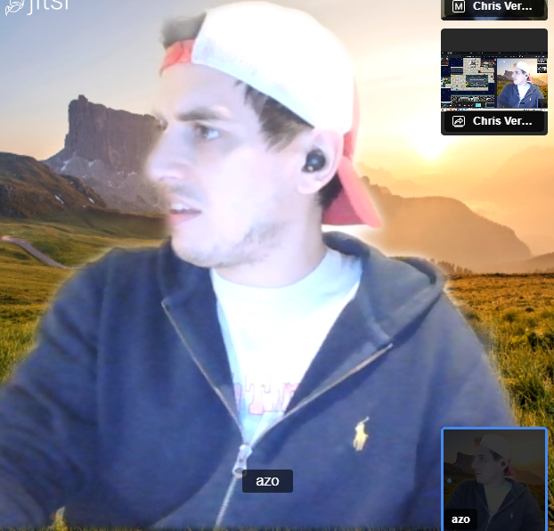
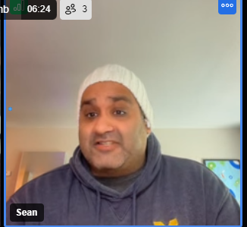
🤝Partnerships
https://www.linkedin.com/in/gordon-tu/

Slide 18
Priority Finding:

Slide 19
FEEDBACK: PollEv.com​/chrisverhoef134

